Slide 1
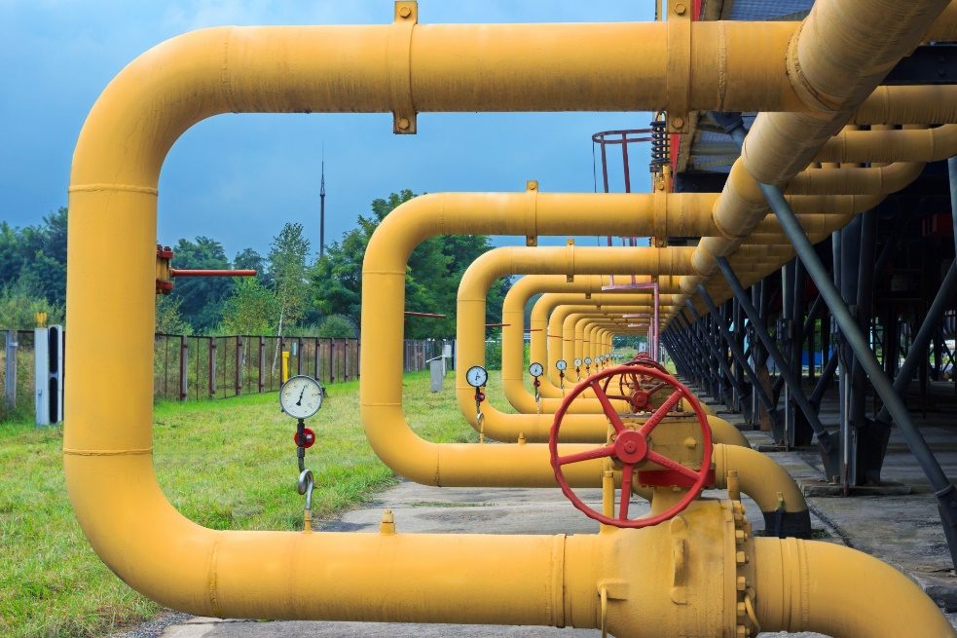
Networking
Addresses and DNS
Ports
TCP
UDP
Notes:
In this lesson we’ll look at computer networks at a high level. These general concepts apply to network programming in all languages. We’ll get to the Python specifics in the next lessons.
Here we’ll look at IP addresses (that’s the a-dot-b-dot-c-dot-d numbers you are familiar with). And we’ll talk about DNS – Domain Name Service – that gives a friendly name like “google dot com” to the dotted numbers.
We’ll look at sockets and port numbers.
Finally, we’ll talk about the two popular protocols on the internet: TCP and UDP. We’ll see how they are different and why we need both.

Slide 2
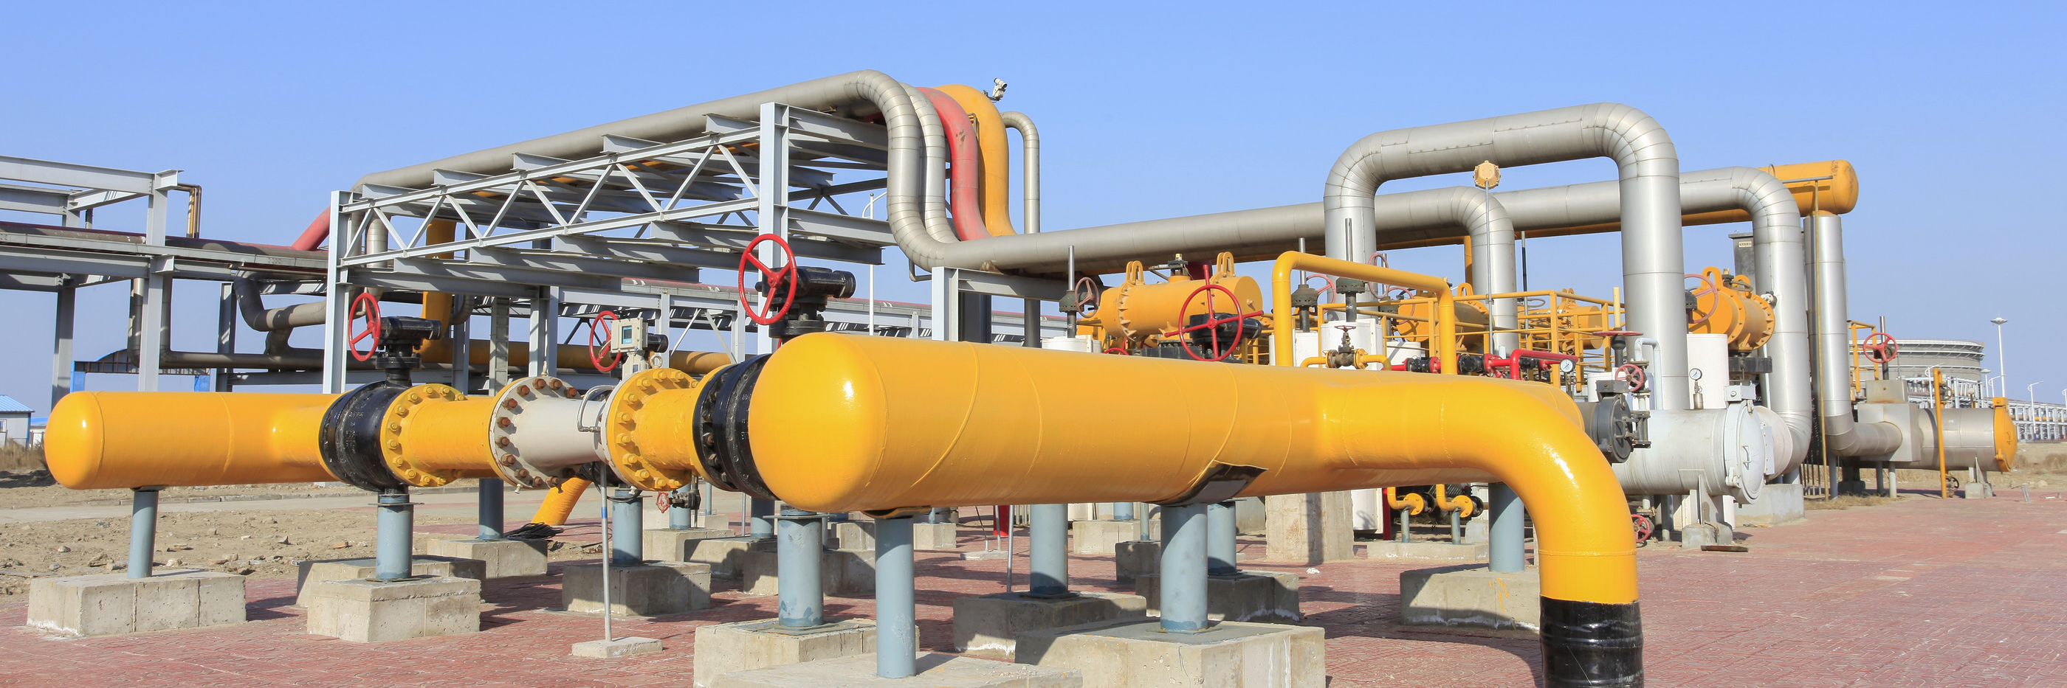
See Also
https://www.tutorialspoint.com/python/python_networking.htm
https://docs.python.org/2/howto/sockets.html
Notes:
Here is some additional reading on the web. If you do a web search for “Python Network Programming” you’ll find all you ever wanted to know!

Slide 3
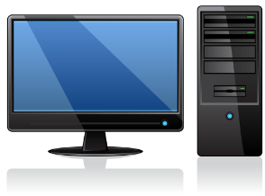
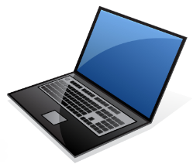
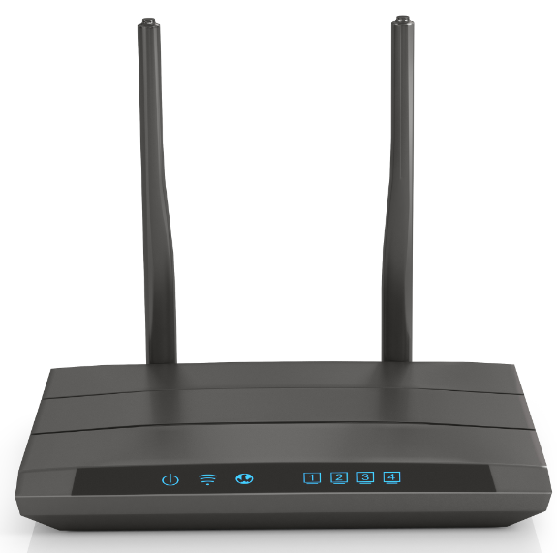
Ethernet
10.2.14.5
DNS
Domain | Address
google.com | 74.125.196.139
amazon.com | 54.239.17.6
uah.edu | 146.229.1.10
1.9.2.1
10.2.14.14
1.9.2.5
10.2.14.8
14.2.2.16
10.2.14.1
14.2.2.7
1.9.2.8
Each machine has a unique address
Routers have multiple connections to bridge networks
DNS maintains a map between name and number
Streams of bytes … two ways (into your program and out of your program)
Disks, consoles, sockets, keyboards, printers
Know how to talk streams and you can talk to anything
Initialization (constructor) is different. Use is the same.
Notes:
Look at these three lonely computers. They are all isolated from each other – and the rest of the world.
@1 But fear not! We are going to connect the three together on a network. Each machine gets a special piece of hardware we call a NIC – a Network Interface Controller.
This wire connecting these three machines might be an actual copper wire. Or it might be a wireless connection using a wifi radio.
@2 These wires aren’t usually connected together directly – physically. There is usually a box here that they all connect to and internally this box makes the actual connection. You likely have one of these boxes at home – a SWITCH or a ROUTER that has a number of plugs for cables and maybe an antenna for wifi connections.
@3 All of these machines have a unique address on the network. This is machine 10.2.14.5. This one .14. This one is .8. The machines send message to one another over the network using these addresses.
Where do these machines get their unique address? Sometimes they are hardcoded into the machine. More commonly they negotiate with the router when they power up and the router gives them a unique address – that might change the next time the machine powers up.
@4 In other parts of the world other people have connected their machines together with their own network.
These machines would like to talk to these machines. But they are on separate networks. How can we connect them?
@5 We add another device to the network that has multiple NICs. It can connect to multiple networks at the same time. This is a ROUTER that forwards traffic from one NIC to another.
@6 It has its own unique address on the network. The other machines on the network know this as their GATEWAY. When they want to send messages outside the network, they send the messages to this device at this address.
@7 Other networks have their own router – their own GATEWAY.
Remember these boxes have multiple interfaces. @8 Here the routers are connected together on a second network. They have unique addresses on this second network.
Let’s say this machine 14.5 wants to send a message to 2.8. It sends the message to 14.1 – its GATEWAY. The router knows that to get to 2.8 it needs to go through this network to 2.16. Then 2.16 routes the message to the correct machine on its other network.
And this is how the Internet is connected. There are multiple levels of routers connecting multiple networks. Often there is more than one way to get from one machine to another. The routers handle the complex routing under the covers – magically as far as you are concerned.
The computers like with these numbers. This is what they work with. @9 but we humans find it easier to remember names.
The DNS – Domain Name Service is a database that maps names to IP addresses. When a computer is given a string name instead of a dotted address, it first contacts the DNS server it has been configured to use. That server translates the name to a dotted address.
And where are these DNS servers? They are spread out all over the web. And they communicate with each other to keep the information up to date. Often your computer sends requests to its default gateway. Google provides free DNS servers at 8.8.8.8 and 8.8.4.4.
You usually don’t worry about your IP address, the gateway address, or the DNS server address – your computer gets all of these from the network when it powers up.

Slide 4
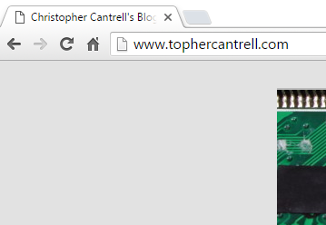
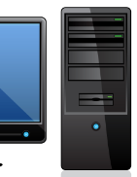
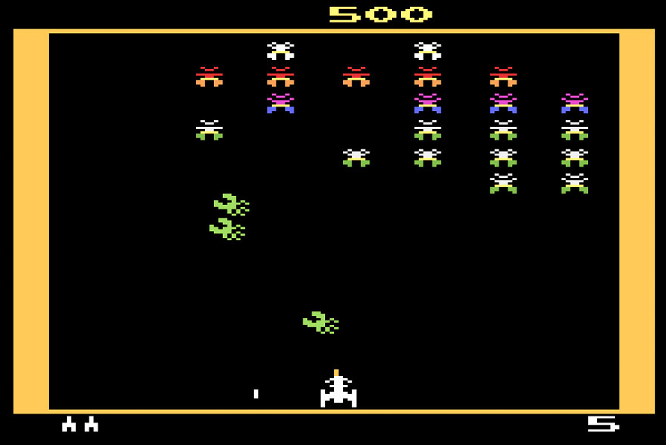
Ports
10.2.14.2
10.2.14.5
Web Server
80
FTP
21
75.75.8.43
Blaster Man
15583
Streams of bytes … two ways (into your program and out of your program)
Disks, consoles, sockets, keyboards, printers
Know how to talk streams and you can talk to anything
Initialization (constructor) is different. Use is the same.
Notes:
There are multiple programs running on your computer that want to talk to the outside world.
These programs all share the same IP address, of course, since they are on the same machine. But they are given a unique PORT number to separate them from other programs at the same address.
@1 For instance, your computer might have a web server. We’ll give it port number 80. Programs out in the world can connect to your web server by knowing your address AND the port number of the web server.
@2 Your computer might be running an FTP server to upload and download files. We’ll give this server port number 21.
@3 And you might be playing the cool video game Blaster Man against your cousin on the other side of the country. We’ll give the Blaster Man program port number 15583 that your cousin’s computer talks to – address and port number.
@4 Here you are on your computer and you want to connect to the web server on my computer. In your browser you put in the domain name “www.tophercantrell.com”. Your computer contacts the DNS server, and it resolves the name as 10.2.14.5.
@5 Your browser knows that web servers have all agreed to be on port 80. The browser connects to the IP address on port 80 and talks to the web server.
@6 Across the country, my cousin and I are playing Blaster Man. His Blaster Man program knows the address of my machine (we configured that when we started the game). It also knows to use port 15583.
@7 His program connects to my machine address and the blaster man port number.

Slide 5
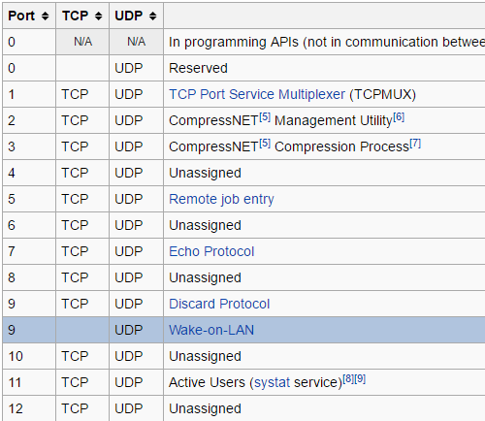
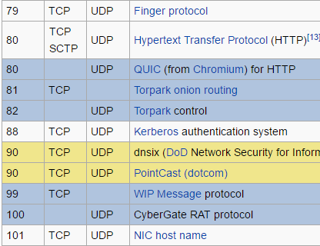
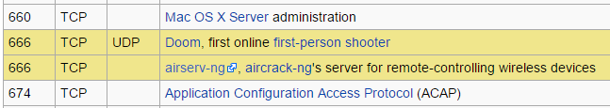
Well-Known and Registered Ports
0 – 1023: Well known ports
1024 – 49151: Assigned by IANA
49152 – 65535: Dynamic, Private, or Ephemeral
11111111
11111111
2¹⁶ = 65,536
https://en.wikipedia.org/wiki/List_of_TCP_and_UDP_port_numbers
Streams of bytes … two ways (into your program and out of your program)
Disks, consoles, sockets, keyboards, printers
Know how to talk streams and you can talk to anything
Initialization (constructor) is different. Use is the same.
Notes:
Who decides what programs get what ports? For instance, who decides that web servers use port 80?
The IANA is the organization that keeps the database of port numbers to programs.
@1 Port numbers are two bytes. That’s 2 to the 16 different values – 65536 different port numbers.
@2 The IANA reserves the first 1024 port number for so called “well known” services. For instance, HTTP (the web) uses port 80. Kerberos programs communicate on port 88.
Remember the 1st person shooter DOOM? You could hook up 4 machines at once – we wasted many hours of our lives playing doom in the early 90s.
Back then, there was no governing body for port numbers. The makers of DOOM just picked a port number and claimed it as their own. And which number did they pick? 666 of course! When the IANA formed, they grandfathered in 666 as reserved for DOOM.
@3 Ports 1024 – 49151 are assigned by the IANA. Now days when a new software program wants to register a port for its dedicated use, it contacts the IANA. The IANA will assign an available port number.
These port numbers aren’t law! You can code your software to use any port number you want. Blaster Man could decide to use port 80 if it wanted. But only one program on your computer can use a given port. If you have a web server running then you couldn’t start blaster man on port 80.
The IANA provides a central way for software developers to keep from colliding with ports being used by other programs.
@4 The upper port numbers starting at 49152 are available for your program to pick and use temporarily. If you are experimenting with network programming you might pick a port number in this range. Again, you can use any number you like. As long as the port number is available on your machine, you won’t run into problems.

Slide 6

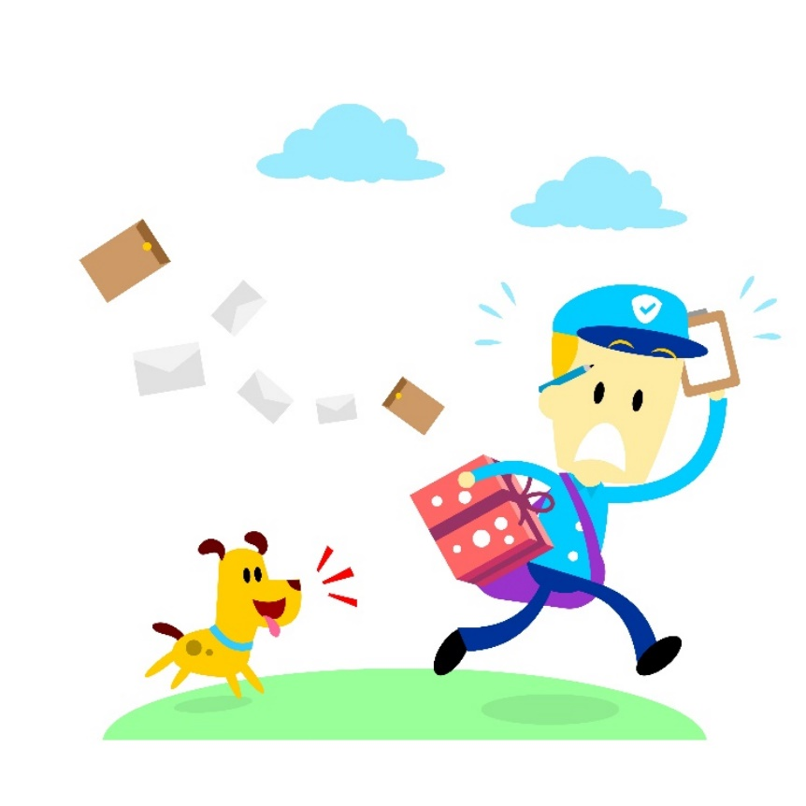
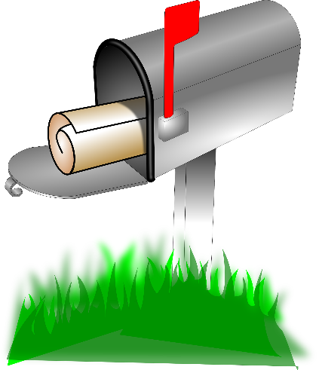

User Datagram Protocol (UDP)
From: 10.2.14.5:502
To: 192.168.1.10:28
To: 192.168.1.10:28
Data Bytes
10.2.14.5:502
192.168.1.10:28
Streams of bytes … two ways (into your program and out of your program)
Disks, consoles, sockets, keyboards, printers
Know how to talk streams and you can talk to anything
Initialization (constructor) is different. Use is the same.
Notes:
I talked about “sending messages”. What’s in one of these “messages”, and how does SENDING and RECEIVING work?
There are two popular kinds of messages – UDP and TCP. We’ll look at both.
UDP is the simplest. The User Datagram Protocol. It works basically like the postal mail system.
Your program has a mailbox identified with the computer’s name – the host name – and the port number.
@1 When you want to send a message you create an envelope.
@2 You put the destination address and port number on the envelope.
@3 Then you put a chunk of data bytes in the envelope. The envelope can only hold a small number of data bytes – usually around fifteen hundred.
@4 Then you put the envelope in your mailbox.
And that’s it! Your part of the process is done!
@5 Eventually the postman comes around and picks up your envelope and delivers it to the destination mailbox.
Well, hopefully. You have no way of knowing if the “other” mailbox is even there or if the message got lost in transit.
@6 But if it DOES get to the destination, then the program that owns the mailbox fetches the envelope and uses the data.
@7 The envelope contains the sender’s address and port number.
That’s UDP

Slide 7
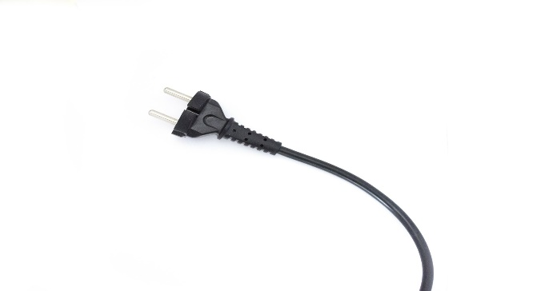
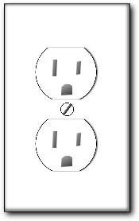
Transmission Control Protocol (TCP)
10.2.14.5:502
192.168.1.10:28
Output Stream
Output Stream
10
B4
22
18
19
4F
19
4F
10
B4
22
18
Input Stream
Input Stream
Connector
Listener
Streams of bytes … two ways (into your program and out of your program)
Disks, consoles, sockets, keyboards, printers
Know how to talk streams and you can talk to anything
Initialization (constructor) is different. Use is the same.
Notes:
TCP is a bit more sophisticated. Again, you have two programs identified by an address and a port number.
@1 Instead of mailboxes, the communication looks more like a pipe.
@2 One side of the connection pumps in a series of bytes.
@3 On the other side of the connection the bytes come out in the same order.
@4 This flow forms a stream of bytes … this program writes to an output stream
@5 And this program reads the bytes from its input stream
@6 The connection is actually TWO INDEPENDENT streams. On the right the program writes to its output stream.
@7 And the data appears in the other program’s input stream.
These two data streams are completely independent.
Best of all, in TCP both sides of the connection talk back and forth to ensure that data arrives and arrives in the correct order. If a packet gets lost then one side requests a resend from the other. All this happens under the covers without your intervention. To your programs, the communication is just magic.
Unlike UDP, there is a persistent connection between programs in TCP. The connection is made, the programs communicate as long as they want, and then the connection is torn down.
There are two POLARITIES in forming the connection.
@8 One side of the connection must come up first and wait for the other side to connect. This side is the “listener” waiting patiently.
@9 The other side of the connection takes an active role and reaches out and connects to the listener. If the listener is not running then the connector gets an error. The listener must be started first.
Once the two sides are connected, there is NO difference between the two programs. The communication is peer to peer.

Slide 8
UDP vs TCP
 | UDP | TCP
Speed | Fast | Slow
Reliability | Unsure | Guaranteed
Ordering | Unsure | Guaranteed
TCP: Web browsing, email
UDP: Streaming media, games
Streams of bytes … two ways (into your program and out of your program)
Disks, consoles, sockets, keyboards, printers
Know how to talk streams and you can talk to anything
Initialization (constructor) is different. Use is the same.
Notes:
TCP, with its guaranteed delivery, seems vastly superior to UDP. Why would you ever need UDP?
Well, let’s compare the two. The UDP protocol is much faster than the TCP protocol. TCP has a lot of smarts built in to resend packets and keep them in order. That smarts takes CPU cycles.
Reliability: With UDP you never know if a message got where it is going. With TCP the data is guaranteed to get to the other side if physically possible.
And ordering: We said that there can be multiple pathways between machines. The routers might choose to send one packet along one wire and another packet along another. With UDP the packets might arrive out of order. But TCP holds “future” packets and waits on the “current” packet. It guarantees that packets will be streamed to your programs in order.
@1 TCP is great for programs like the web browser and email. Every packet is crucial. You want all the data and you want it in order.
@2 But for streaming video, speed is the key. The video is constantly being updated on the screen. If a packet gets lost, then you get a short flicker on the screen. But you don’t want the video to pause waiting on the past frame to be resent. That lost frame is old news. We have new frames to worry about.

Slide 9

Tinkering
Open a command prompt in your virtual machine and enter the following commands:
“ipconfig /all”
“tracert google.com”
What information are these commands giving?
How does the output compare to the same commands running on your personal computer?
Notes:
Here are some optional exercises for you. There is nothing for you to send to me.
Open a command prompt on your virtual lab machine and on your home computer. Try these commands on both machines.
What information does each command give you?
How do the outputs between machines compare?
Send me email if you have any questions or comments. See you next time.

